Slide 1
Machine learning assisted Identification of topological magnetism
Nathan Drucker
Quantum Matter Group meeting
9/4/2020

Slide 2
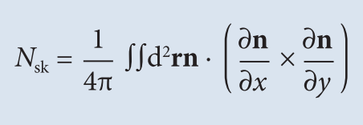
Skyrmions: Emergent topological magnetism
exchange
DMI
Zeeman
Anisotropy/
dipole
Source: Wikipedia

Slide 3
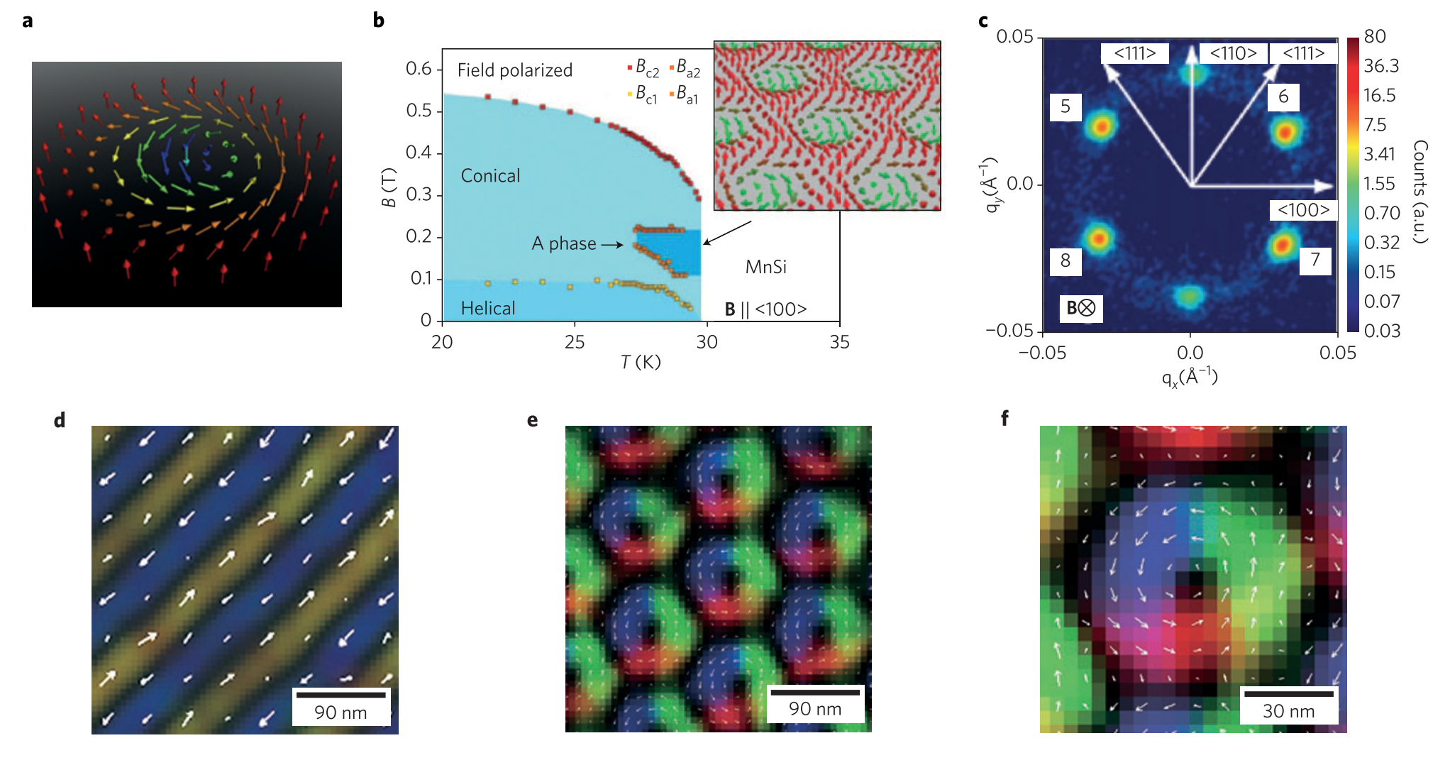
Experimental Observation
Nagaosa, Tokura
﻿DOI: 10.1038/NNANO.2013.243
Topological

Slide 4
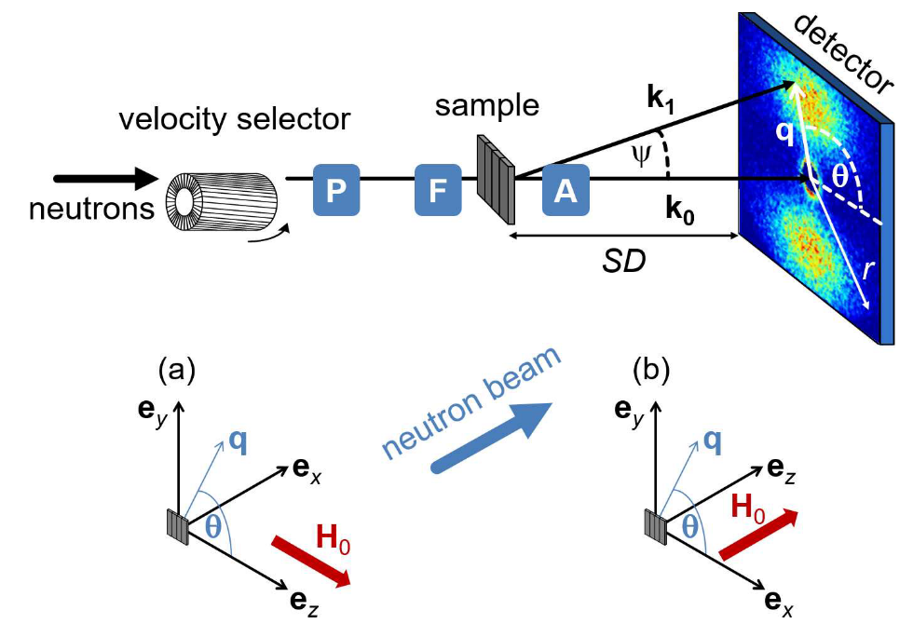
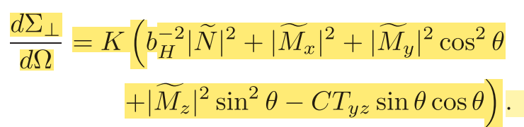
Experimental Technique:
Small Angle Neutron Scattering (SANS)

Slide 5
ML Workflow
Topology
Class
Spectrum (real)
CNN
Train/Test (Simulation)
Topology
class
Energy Params
Spectrum
Ubermag
Geometry Params
SANS eqns
Processing

Slide 6
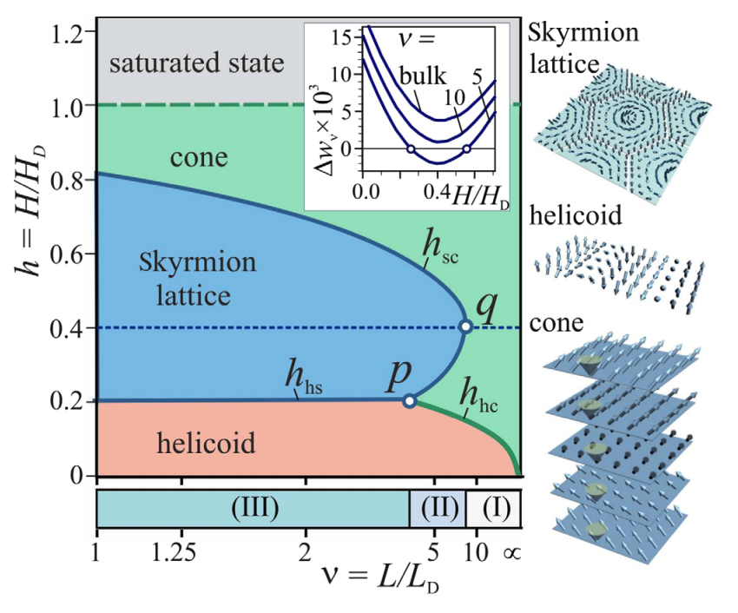
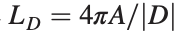
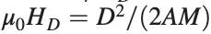
Simulation: Reduce phase space size
Note: A is exchange stiffness
Leonov et al.
﻿10.1103/PhysRevLett.117.087202

Slide 7
H=0
H=.1
H=.2
h=.5
H=.9
H=1.5

Slide 8
From simulation to cross section:

Slide 9
From simulation to cross section:

Slide 10
Classifying Simulations

Slide 11
Convolutional Neural Network results
~200 data points: need more!

Slide 12
Diversity of topological structures
Skyrmion lattice
Disordered SkL
Meron-Antimeron lattice
Goal: Classify each of these!

Slide 13
Next steps
Simulate more data points (optimization+parallelization)
Investigate role of thermal fluctuations
Explore other phase-spaces (e.g. Anisotropy vs H, H vs T …)
Identify more detailed magnetic phases (multi—class)
Use on real data!
Learn Hamiltonian parameters from experimental data (regression)

